Slide 1
Processor Design
5Z032
Arithmetic for Computers
Henk Corporaal
Eindhoven University of Technology
2011

Slide 2
Topics
Arithmetic
Signed and unsigned numbers
Addition and Subtraction
Logical operations
ALU: arithmetic and logic unit
Multiply
Divide
Floating Point
  notation
  add
  multiply

Slide 3
Arithmetic
Where we've been:
  Performance (seconds, cycles, instructions)
  Abstractions:
  Instruction Set Architecture
  Assembly Language and Machine Language
What's up ahead:
  Implementing the Architecture
operation
a
32
ALU
result
32
b
32

Slide 4
Binary numbers (1)
Bits have no inherent meaning (no semantics)
Decimal number system, e.g.:
4382 = 4x10³ + 3x10² + 8x10¹ + 2x10⁰
Can use arbitrary base g; value of digit c at position i:
c x g^{i}
Binary numbers (base 2)
  n-1 n-2 … 1 0
  a_{n-1} a_{n-2} … a₁ a₀
  2^{n-1} 2^{n-2} … 2¹ 2⁰
(a_{n-1} a_{n-2}... a₁ a₀) _{two} = a_{n-1} x 2^{n-1} + a_{n-2} x 2^{n-2} + … + a₀ x 2⁰
position
digit
weight

Slide 5
Binary numbers (2)
So far numbers are unsigned
With n bits 2^{n} possible combinations
  a₀ : least significant bit (lsb)
  a_{n-1}: most significant bit (msb)
1 bit 2 bits 3 bits 4 bits decimal value
0 00 000 0000 0
1 01 001 0001 1
10 010 0010 2
11 011 0011 3
100 0100 4
101 0101 5
110 0110 6
111 0111 7
1000 8
1001 9

Slide 6
Binary numbers (3)
Binary numbers (base 2)
0000 0001 0010 0011 0100 0101 0110 0111 1000 1001...
decimal: 0...2^{n}-1
Of course it gets more complicated:
- numbers are finite (overflow)
- fractions and real numbers
- negative numbers
  e.g., no MIPS subi instruction;
  however, addi can add a negative number
How do we represent negative numbers?
i.e., which bit patterns will represent which numbers?

Slide 7
Conversion
Decimaal -> binair
      Divide by 2 Remainder
Hexadecimal: base 16. Octal: base 8
      1010 1011 0011 1111_{two} = ab3f_{hex}
4382
2191 0
1095 1
547 1
273 1
136 1
68 0
34 0
17 0
8 1
4 0
2 0
1 0
0 1
4382_{ten} =
1 0001 0001 1110_{two}

Slide 8
Signed binary numbers
Possible representations:
Sign Magnitude: One's Complement Two's Complement
000 = +0 000 = +0 000 = +0
001 = +1 001 = +1 001 = +1
010 = +2 010 = +2 010 = +2
011 = +3 011 = +3 011 = +3
100 = -0 100 = -3 100 = -4
101 = -1 101 = -2 101 = -3
110 = -2 110 = -1 110 = -2
111 = -3 111 = -0 111 = -1
Issues: balance, number of zeros, ease of operations
Which one is best? Why?

Slide 9
Two’s complement
(let’s restrict to 4 bits)
0000
1111
0001
-1
0
1
0010
1110
15
-2
2
14
1101
-3
0011
13
3
-4
12
positive
1100
4
0100
negative
11
-5
5
1011
0101
10
-6
9
6
1010
8
0110
-7
7
-8
1001
0111
1000

Slide 10
Two’s complement
3+2=5
0000
1111
0001
-1
0
1
0010
1110
15
-2
2
14
1101
-3
0011
13
3
-4
12
positive
1100
4
0100
negative
11
-5
5
1011
0101
10
-6
9
6
1010
8
0110
-7
7
-8
1001
0111
1000

Slide 11
Two’s complement
3+ (-5) = -2
0000
1111
0001
-1
0
1
0010
1110
15
-2
2
14
1101
-3
0011
13
3
-4
12
positive
1100
4
0100
negative
11
-5
5
1011
0101
10
-6
9
6
1010
8
0110
-7
7
-8
1001
0111
1000

Slide 12
Two’s complement
3+6 = -7 !!
overflow
0000
1111
0001
-1
0
1
0010
1110
15
-2
2
14
1101
-3
0011
13
3
-4
12
positive
1100
4
0100
negative
11
-5
5
1011
0101
10
-6
9
6
1010
8
0110
-7
7
-8
1001
0111
1000

Slide 13
Two’s complement
-3 + (-6) = 7 !!
underflow
0000
1111
0001
-1
0
1
0010
1110
15
-2
2
14
1101
-3
0011
13
3
-4
12
positive
1100
4
0100
negative
11
-5
5
1011
0101
10
-6
9
6
1010
8
0110
-7
7
-8
1001
0111
1000

Slide 14
Two’s complement
maxint
32 bit signed numbers:
0000 0000 0000 0000 0000 0000 0000 0000_{two} = 0_{ten}
0000 0000 0000 0000 0000 0000 0000 0001_{two} = + 1_{ten}
0000 0000 0000 0000 0000 0000 0000 0010_{two} = + 2_{ten}
...
0111 1111 1111 1111 1111 1111 1111 1110_{two} = + 2,147,483,646_{ten}
0111 1111 1111 1111 1111 1111 1111 1111_{two} = + 2,147,483,647_{ten}
1000 0000 0000 0000 0000 0000 0000 0000_{two} = – 2,147,483,648_{ten}
1000 0000 0000 0000 0000 0000 0000 0001_{two} = – 2,147,483,647_{ten}
1000 0000 0000 0000 0000 0000 0000 0010_{two} = – 2,147,483,646_{ten}
...
1111 1111 1111 1111 1111 1111 1111 1101_{two} = – 3_{ten}
1111 1111 1111 1111 1111 1111 1111 1110_{two} = – 2_{ten}
1111 1111 1111 1111 1111 1111 1111 1111_{two} = – 1_{ten}
  Range [-2 ³¹ .. 2 ³¹ -1]
(a_{n-1} a_{n-2}... a₁ a₀) _{2’s-compl} = -a_{n-1} x 2^{n-1} + a_{n-2} x 2^{n-2} + … + a₀ x 2⁰ = - 2^{n} + a_{n-1} x 2^{n-1} + … + a₀ x 2⁰
minint

Slide 15
Two's Complement Operations
Negating a two's complement number: invert all bits and add 1
  remember: “negate” and “invert” are quite different!
Proof:
a + a = 1111.1111b = -1 d =>
-a = a + 1

Slide 16
Two's Complement Operations
Converting n bit numbers into numbers with more than n bits:
  MIPS 8 bit, 16 bit values / immediates converted to 32 bits
Copy the most significant bit (the sign bit) into the other bits
0010 -> 0000 0010
1010 -> 1111 1010
MIPS "sign extension" example instructions:
    lb load byte (signed)
    lbu load byte (unsigned)
    slti set less than immediate (signed)
    sltiu set less than immediate (unsigned)

Slide 17
Addition & Subtraction
Just like in grade school (carry/borrow 1s)
0111 0111 0110
+ 0110 - 0110 - 0101
Two's complement operations easy
  subtraction using addition of negative numbers
  0110 0110
  - 0101 + 1010
Overflow (result too large for finite computer word):
  e.g., adding two n-bit numbers does not yield an n-bit number
  0111
  + 0001 note that overflow term is somewhat misleading,
  1000 it does not mean a carry “overflowed”

Slide 18
Detecting Overflow
No overflow when adding a positive and a negative number
No overflow when signs are the same for subtraction
Overflow occurs when the value affects the sign:
  overflow when adding two positives yields a negative
  or, adding two negatives gives a positive
  or, subtract a negative from a positive and get a negative
  or, subtract a positive from a negative and get a positive
Consider the operations A + B, and A – B
  Can overflow occur if B is 0 ?
  Can overflow occur if A is 0 ?

Slide 19
Effects of Overflow
When an exception (interrupt) occurs:
  Control jumps to predefined address for exception
  (interrupt vector)
  Interrupted address is saved for possible resumption in exception program counter (EPC); new instruction: mfc0
  (move from coprocessor0)
  Interrupt handler handles exception (part of OS).
  registers $k0 and $k1 reserved for OS
Details based on software system / language
  C ignores integer overflow; FORTRAN not
Don't always want to detect overflow
— new MIPS instructions: addu, addiu, subu
note: addiu and sltiu still sign-extends!

Slide 20
Logic operations
Sometimes operations on individual bits needed:
    Logic operation C operation MIPS instruction
    Shift left logical << sll
    Shift right logical >> srl
    Bit-by-bit AND & and, andi
    Bit-by-bit OR | or, ori
and and andi can be used to turn off some bits;
or and ori turn on certain bits
Of course, AND en OR can be used for logic operations.
  Note: Language C’s logical AND (&&) and OR (||) are conditional
andi and ori perform no sign extension !

Slide 21
Exercise: gates
Given: 3-input logic function of A, B and C, 2-outputs
Output D is true if at least 2 inputs are true
Output E is true if odd number of inputs true
Give truth-table
Give logic equations
Give implementation with AND and OR gates, and Inverters.

Slide 22
An ALU (arithmetic logic unit)
Let's build an ALU to support the andi and ori instructions
  we'll just build a 1 bit ALU, and use 32 of them
operation
a
result
b

Slide 23
Review: The Multiplexor
Selects one of the inputs to be the output, based on a control input
Lets build our ALU and use a MUX to select the
outcome for the chosen operation
S
note: we call this a 2-input mux
even though it has 3 inputs!
A
0
C
B
1

Slide 24
Different Implementations
Not easy to decide the “best” way to build something
  Don't want too many inputs to a single gate
  Don’t want to have to go through too many gates
  For our purposes, ease of comprehension is important
Let's look at a 1-bit ALU for addition (= full-adder):
CarryIn
c_{out} = a b + a c_{in} + b c_{in}
sum = a xor b xor c_{in}
a
+
Sum
b
CarryOut
How could we build a 1-bit ALU for add, and, and or?
How could we build a 32-bit ALU?

Slide 25
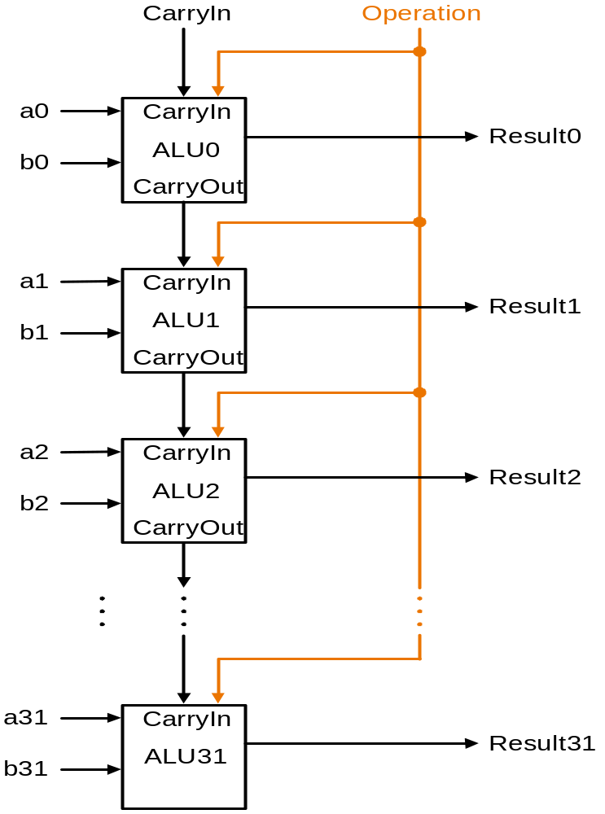
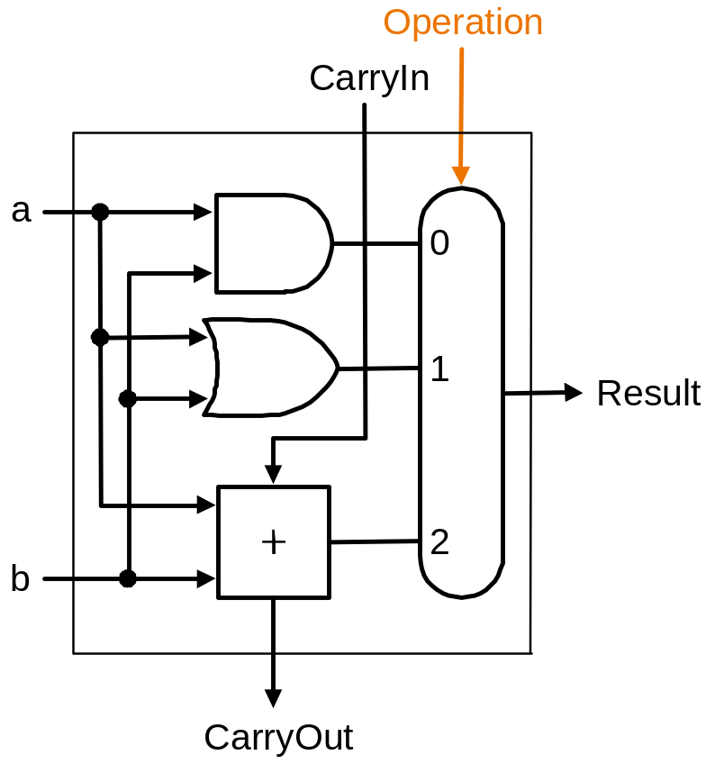
Building a 32 bit ALU

Slide 26
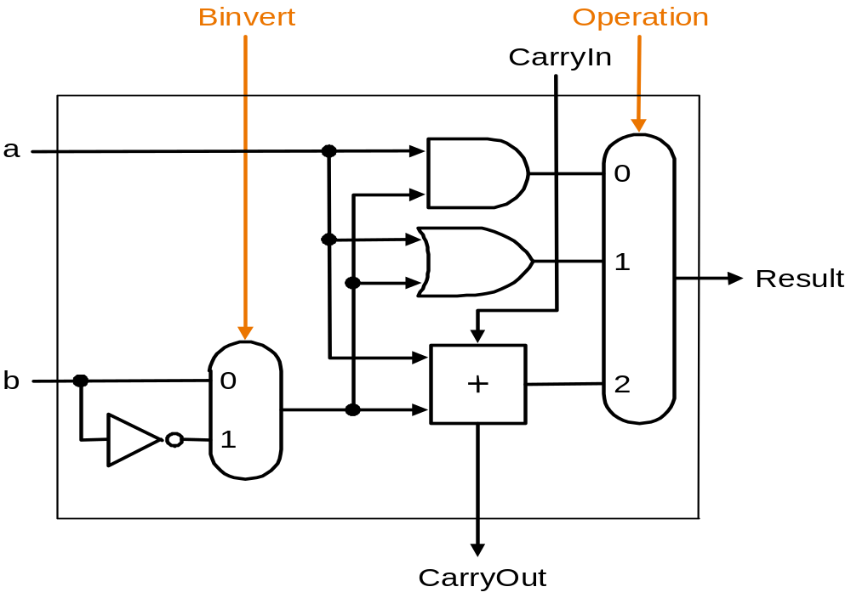
What about subtraction (a – b) ?
Two's complement approach: just negate b and add
How do we negate?
A very clever solution:

Slide 27
Tailoring the ALU to the MIPS
Need to support the set-on-less-than instruction (slt)
  remember: slt rd,rs,rt is an arithmetic instruction
  produces a 1 if rs < rt and 0 otherwise
  use subtraction: (a-b) < 0 implies a < b
Need to support test for equality
  beq $t5, $t6, label
  jump to label if $t5 = $t6
  use subtraction: (a-b) = 0 implies a = b

Slide 28
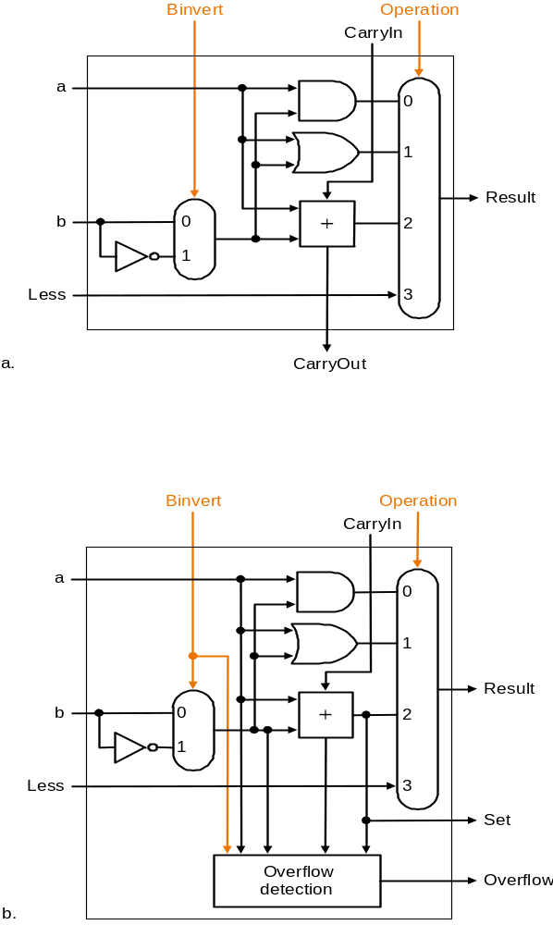
Supporting 'slt'
Can we figure out the idea?
(fig. 4.17 2nd ed.)
bits 0-30
bit 31

Slide 29
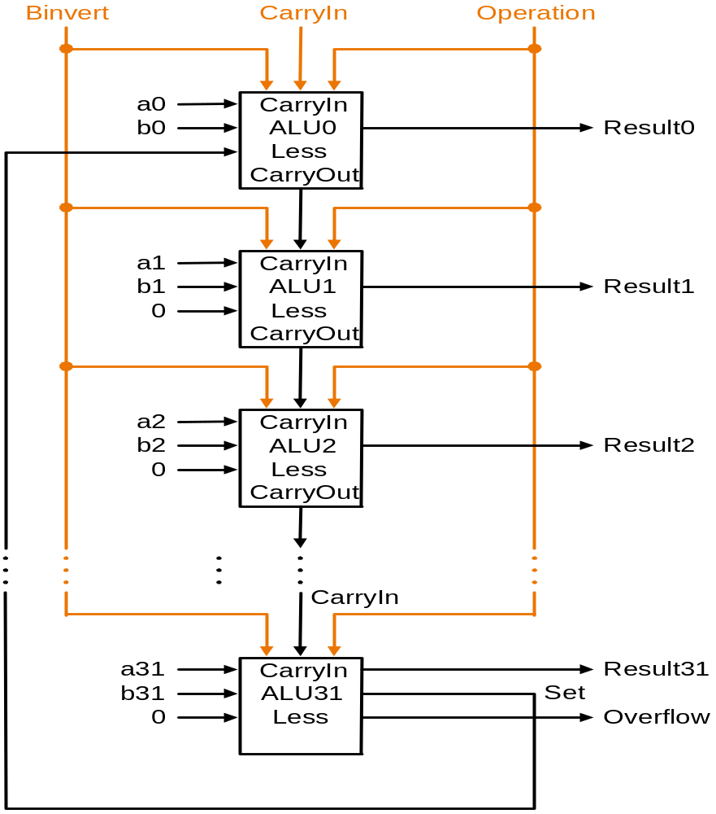
Supporting the ‘slt’ operation

Slide 30
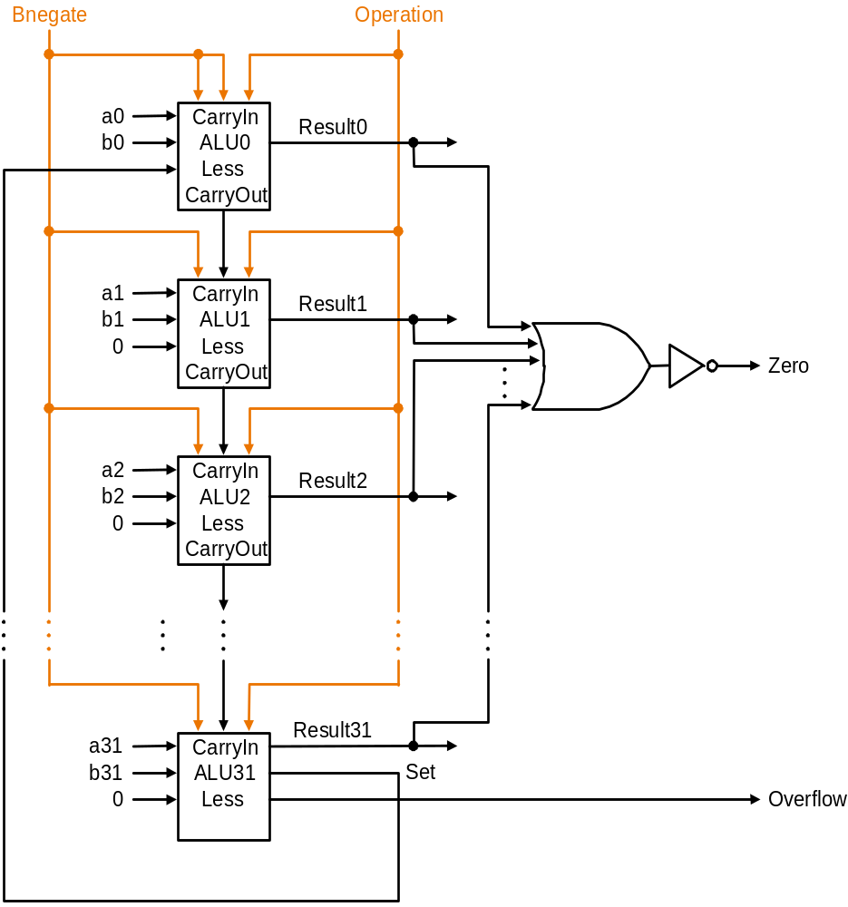
Test for equality
a-b = 0 ⇔a=b
Notice control lines:
000 = and
001 = or
010 = add
110 = subtract
111 = slt
Note: signal Zero is a 1 when the
result is zero!
The Zero output is always calculated

Slide 31
ALU symbol
operation
32
a
zero
ALU
32
result
overflow
32
b
carry-out

Slide 32
Conclusions
We can build an ALU to support the MIPS instruction set
  key idea: use multiplexor to select the output we want
  we can efficiently perform subtraction using two’s complement
  we can replicate a 1-bit ALU to produce a 32-bit ALU
Important points about hardware
  all of the gates are always working
    not efficient from energy perspective !!
  the speed of a gate is affected by the number of connected outputs it has to drive (so-called Fan-Out)
  the speed of a circuit is affected by the number of gates in series
  (on the “critical path” or the “deepest level of logic”)
    Unit of measure: FO4 = inverter with Fan-Out of 4
    P4 (heavily superpipelined) has about 15 FO4 critical path

Slide 33
Problem: Ripple carry adder is slow
Is a 32-bit ALU as fast as a 1-bit ALU?
Is there more than one way to do addition?
  Two extremes: ripple carry and sum-of-products
  How many logic layers do we need for these two extremes?
Can you see the ripple? How could you get rid of it?
c₁ = b₀c₀ + a₀c₀ + a₀b₀
c₂ = b₁c₁ + a₁c₁ + a₁b₁ c₂ = (..subst c₁..)
c₃ = b₂c₂ + a₂c₂ + a₂b₂ c₃ =
c₄ = b₃c₃ + a₃c₃ + a₃b₃ c₄ =
Not feasible! Why not?

Slide 34
Carry-lookahead adder (1)
An approach in-between our two extremes
Motivation:
  If we didn't know the value of carry-in, what could we do?
  When would we always generate a carry? g_{i} = a_{i} b_{i}
  When would we propagate the carry? p_{i} = a_{i} + b_{i}
Cin
a
b
Cout = Gi + Pi Cin
Cout

Slide 35
Carry-lookahead adder (2)
Did we get rid of the ripple?
c₁ = g₀ + p₀c₀
c₂ = g₁ + p₁c₁ c₂ = g₁ + p₁(g₀ + p₀c₀)
c₃ = g₂ + p₂c₂ c₃ =
c₄ = g₃ + p₃c₃ c₄ =
a0
Cin
4
Result0-3
Feasible ?
b0
a1
b1
ALU
a2
b2
P0
a3
G0
b3
P0 = p₀.p₁.p₂.p₃
G0= g₃+(p₃.g₂)+(p₃.p₂.g₁)+(p₃.p₂.p₁.g₀)

Slide 36
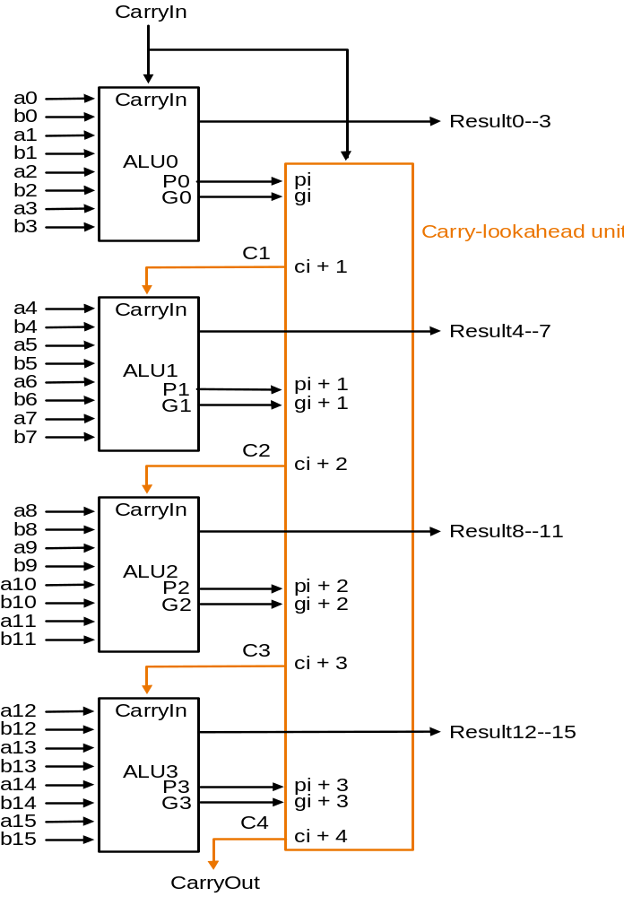
Carry-lookahead adder (3)
Use principle to build bigger adders
Can’t build a 16 bit adder this way... (too big)
Could use ripple carry of 4-bit CLA adders
Better: use the CLA principle again!

Slide 37
Multiplication (1)
More complicated than addition
  accomplished via shifting and addition
More time and more area
Let's look at 3 versions based on gradeschool algorithm
0010 (multiplicand)
__*_1011 (multiplier)
Negative numbers: convert and multiply
  there are better techniques, we won’t look at them now

Slide 38
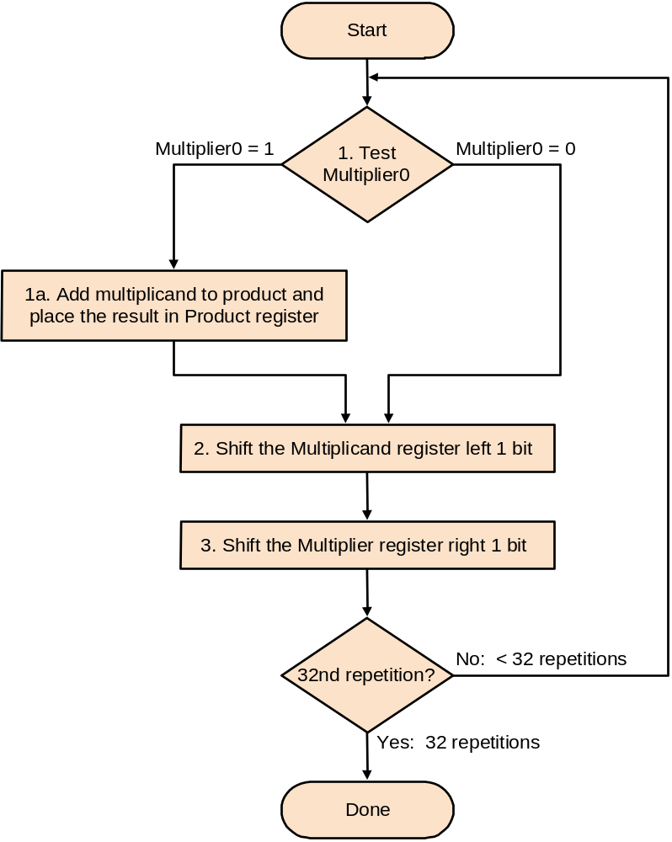
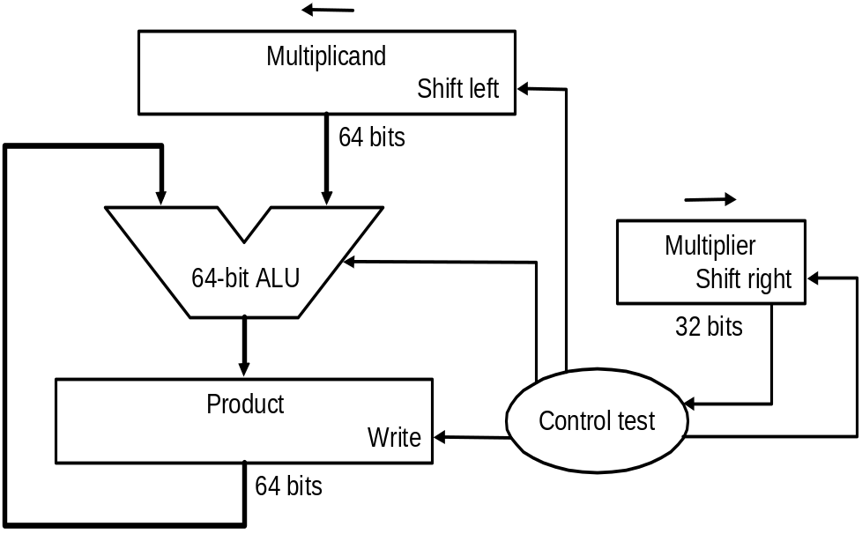
Multiplication (2)
First implementation
Product initialized to 0

Slide 39
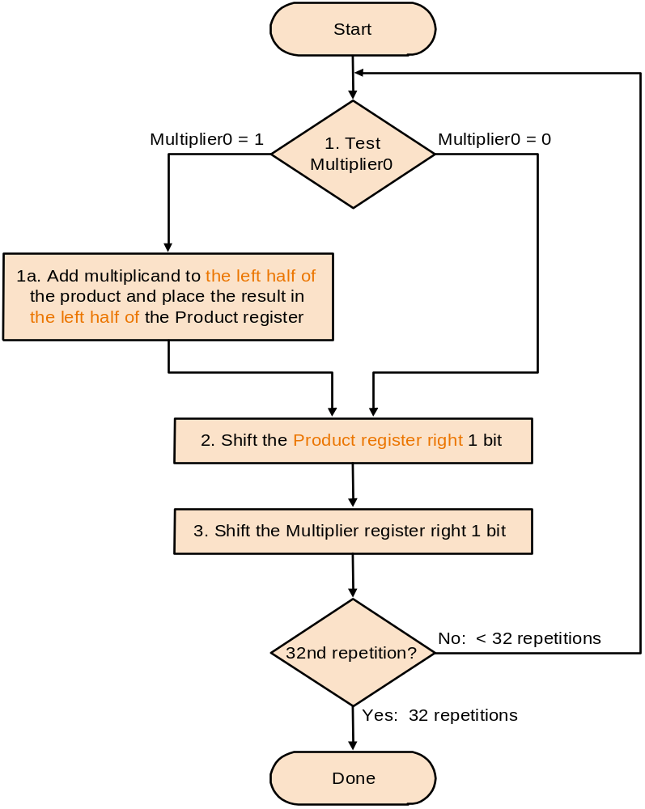
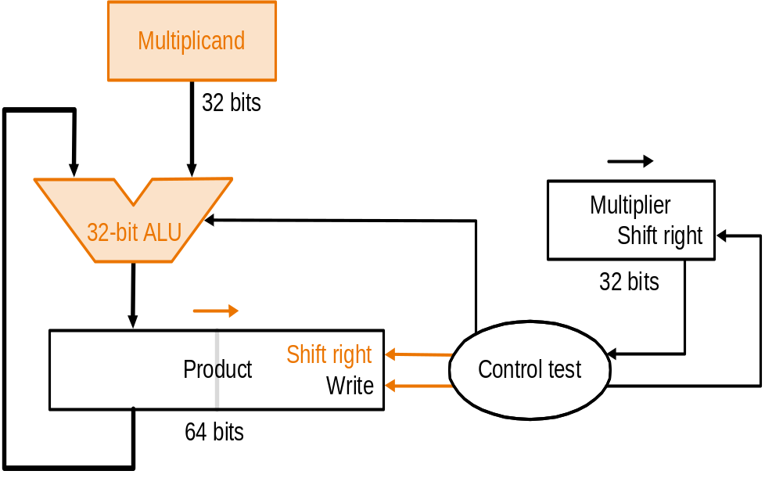
Multiplication (3)
Second version

Slide 40
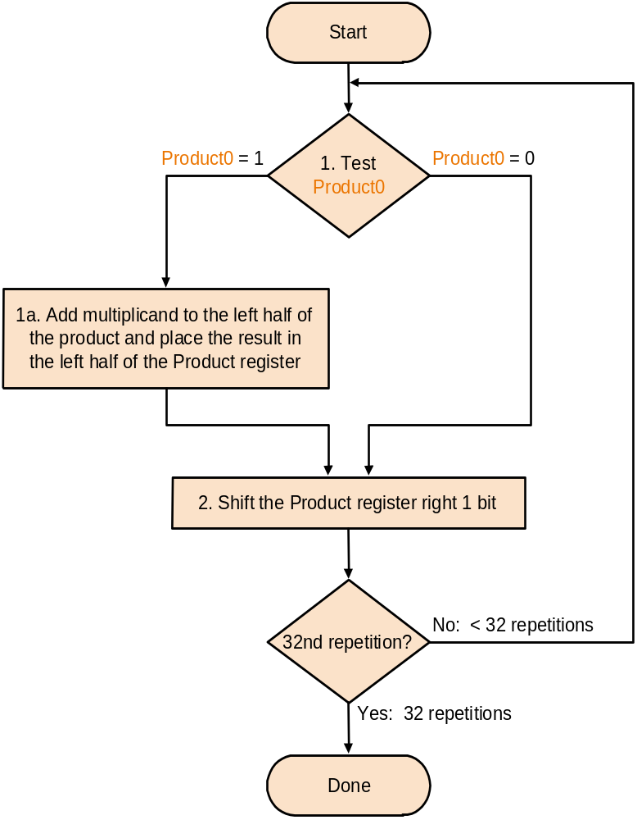
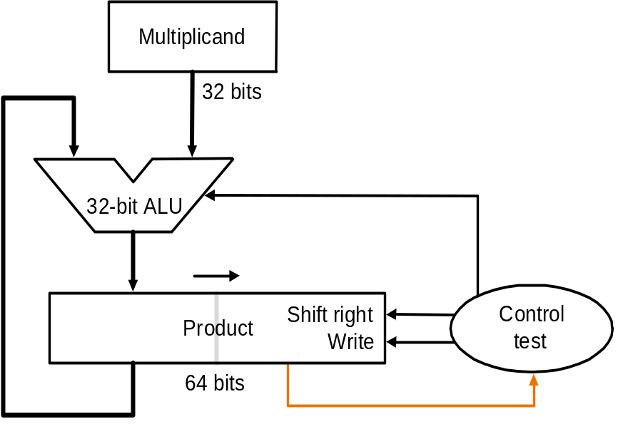
Multiplication (4)
Final version
Product initialized with multiplier

Slide 41
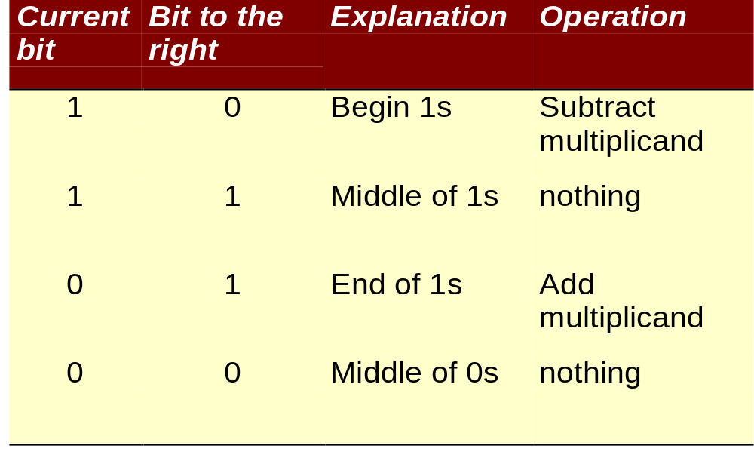
Fast multiply: Booth’s Algorithm
Exploit the fact that: 011111 = 100000 - 1
Therefore we can replace multiplier, e.g.:
0001111100 = 0010000000 - 100
Rules:

Slide 42
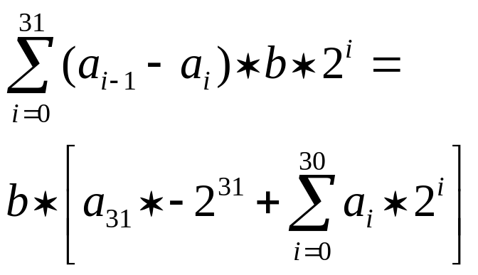
Booth’s Algorithm (2)
Booth’s algorithm works for signed 2’s complement as well (without any modification)
Proof: let’s multiply b * a
(a_{i-1} - a_{i} ) indicates what to do:
0 : do nothing
+1: add b
-1 : subtract
We get b*a =
This is exactly what we need !

Slide 43
Division
Similar to multiplication: repeated subtract
The book discusses again three versions

Slide 44
Divide (1)
Well known algorithm:
Dividend
Divisor 1000/1001010\1001 Quotient
-1000
10
101
1010
-1000
10 Remainder

Slide 45
Division (2)
Start
1. Substract the Divisor register from the
Remainder register and place the
result in the Remainder register
Implementation:
Test Remainder
>= 0
< 0
2.a Shift the Quotient register
to the left, setting the
rightmost bit to 1
2.b Restore the original value by
adding the Divisor register. Also,
shift a 1 into the Quotient register
Divisor
Shift right
Shift Divisor Register right 1 bit
6
4
b
i
t
s
Quotient
33rd repetition?
no
6
4
-
b
i
t
A
L
U
Shift left
3
2
b
i
t
s
Remainder
yes
W
r
i
t
e
C
o
n
t
r
o
l
t
e
s
t
6
4
b
i
t
s
Done

Slide 46
Multiply / Divide in MIPS
MIPS provides a separate pair of 32-bit registers for the result of a multiply and divide: Hi and Lo
mult $s2,$s3 # Hi,Lo = $s2 * $s3
div $s2,$s3 # Hi,Lo = $s2 mod $s3, $s2 / $s3
Copy result to general purpose register
mfhi $s1 # $s1 = Hi
mflo $s1 # $s1 = Lo
There are also unsigned variants of mult and div:
multu and divu

Slide 47
Shift instructions
sll
srl
sra
Why not ‘sla’ instruction ?
Shift: a quick way to multiply and divide with power of 2 (strength reduction). Is this always allowed?

Slide 48
Floating Point (a brief look)
We need a way to represent
  numbers with fractions, e.g., 3.1416
  very small numbers, e.g., .000000001
  very large numbers, e.g., 3.15576 × 10⁹
Representation:
  sign, exponent, significand: (–1)^{sign} × significand × 2^{exponent}
  more bits for significand gives more accuracy
  more bits for exponent increases range
IEEE 754 floating point standard:
  single precision : 8 bit exponent, 23 bit significand
  double precision: 11 bit exponent, 52 bit significand

Slide 49
IEEE 754 floating-point standard
Leading “1” bit of significand is implicit
Exponent is “biased” to make sorting easier
  all 0s is smallest exponent all 1s is largest
  bias of 127 for single precision and 1023 for double precision
  summary: (–1)^{sign} × (1+significand) × 2^{exponent – bias}
Example:
  decimal: -.75 = -3/4 = -3/2²
  binary : -.11 = -1.1 x 2⁻¹
  floating point: exponent = -1+bias = 126 = 01111110
  IEEE single precision:
31 30 29 28 27 26 25 24 23 22 21 20 19 18 17 16 15 14 13 12 11 10 9 8 7 6 5 4 3 2 1 0
1 0 1 1 1 1 1 1 0 1 0 0 0 0 0 0 0 0 0 0 0 0 0 0 0 0 0 0 0 0 0 0

Slide 50
Floating Point Complexities
Operations more complicated: align, renormalize, ...
In addition to overflow we can have “underflow”
Accuracy can be a big problem
  IEEE 754 keeps two extra bits, guard and round, and additional sticky bit (indicating if one of the remaining bits unequal zero)
  four rounding modes
  positive divided by zero yields “infinity”
  zero divide by zero yields “not a number”
  other complexities
Implementing the standard can be tricky
Not using the standard can be even worse
  see text for description of 80x86 and Pentium bug!

Slide 51
Floating Point on MIPS
Separate register file for floats: 32 single precision registers; can be used as 16 doubles
MIPS-1 floating point instruction set (pg 288/291)
  addition add.f (f =s (single) or f=d (double))
  subtraction sub.f
  multiplication mul.f
  division div.f
  comparison c.x.f where x=eq, neq, lt, le, gt or ge
    sets a bit in (implicit) condition reg. to true or false
  branch bc1t (branch if true) and bclf (branch if false)
    c1 means instruction from coprocessor one !
  load and store: lwc1, swc1
Study examples on page 293, and 294-296

Slide 52
Floating Point on MIPS
MIPS has 32 single-precision FP registers ($f0,$f1, …,$f31) or 16 double-precision ($f0,$f2,...)
MIPS FP instructions:
FP add single add.s $f0,$f1,$f2 $f0 = $f1+$f2
FP substract single sub.s $f0,$f1,$f2 $f0 = $f1-$f2
FP multiply single mul.s $f0,$f1,$f2 $f0 = $f1x$f2
FP divide single div.s $f0,$f1,$f2 $f0 = $f1/$f2
FP add double add.d $f0,$f2,$f4 $f0 = $f2+$f4
FP substract double sub.d $f0,$f2,$f4 $f0 = $f2-$f4
FP multiply double mul.d $f0,$f2,$f4 $f0 = $f2x$f4
FP divide double div.d $f0,$f2,$f4 $f0 = $f2/$f4
load word coprocessor 1 lwc1 $f0,100($s1) $f0 = Memory[$s1+100]
store word coprocessor 1 swc1 $f0,100($s1) Memory[$s1+100] = $f0
branch on copr.1 true bc1t 25 if (cond) goto PC+4+100
branch on copr.1 false bc1f 25 if (!cond) goto PC+4+100
FP compare single c.lt.s $f0,$f1 cond = ($f0 < $f1)
FP compare double c.ge.d $f0,$f2 cond = ($f0 >= $f2)

Slide 53
Conversion: decimal ➔ IEEE 754 FP
Decimal number (base 10)
    123.456 = 1x10²+2x10¹+3x10⁰+4x10⁻¹+5x10⁻²+6x10⁻³
Binary number (base 2)
    101.011 = 1x2²+0x2¹+1x2⁰+0x2⁻¹+1x2⁻²+1x2⁻³
Example conversion: 5.375
  Multiply with power of 2, to get rid of fraction:
    5.375 = 5.375x16 / 16 = 86 x 2⁻⁴
  Convert to binary, and normalize to 1.xxxxx
    86 x 2⁻⁴ = 1010110 x 2⁻⁴ = 1.01011 x 2²
  Add bias (127 for single precision) to exponent:
    exponent field = 2 + 127 = 129 = 1000 0001
  IEEE single precision format (remind the leading “1” bit):
0 10000001 01011000000000000000000
sign exponent significand

Slide 54
Floating point on Intel 80x86
8087 coprocessor announced in 1980 as an extension of the 8086
(similar 80287, 80387)
80 bit internal precision (extended double format)
8 entry stack architecture
addressing modes:
  one operand = TOS
  other operand is TOS, ST(i) or in Memory
Four types of instructions (table 4.49 page 303):
  data transfer
  arithmetic
  compare
  transcendental (tan, sin, cos, arctan, exponent, logarithm)

Slide 55
Fallacies and pitfalls
Associative law does not hold:
(x+y) + z is not always equal x + (y+z)
(see example pg 304)

Slide 56
Summary
Computer arithmetic is constrained by limited precision
Bit patterns have no inherent meaning but standards do exist
  two’s complement
  IEEE 754 floating point
Computer instructions determine “meaning” of the bit patterns
Performance and accuracy are important so there are many complexities in real machines (i.e., algorithms and implementation).
We are ready to move on (and implement the processor)
you may want to look back (Section 4.12 is great reading!)

Slide 57
Exercises
From Chapter four (2nd ed.):
4.1, 4.2, 4.4 - 4.8
4.10, 4.12, 4.13
4.14
4.16, 4.20
4.25
4.36
4.40
4.49, 4.50

